Slide 1
EIGRP
Routing Protocols and Concepts – Chapter 9

Slide 2
Objectives
Describe the background and history of Enhanced Interior Gateway Routing Protocol (EIGRP).
Examine the basic EIGRP configuration commands and identify their purposes.
Calculate the composite metric used by EIGRP.
Describe the concepts and operation of DUAL.
Describe the uses of additional configuration commands in EIGRP.

Slide 3
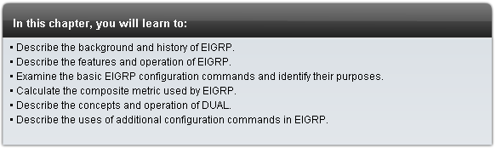
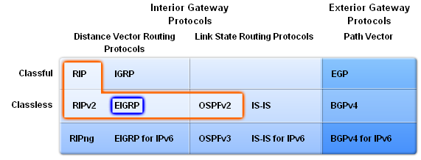
Introduction

Slide 4
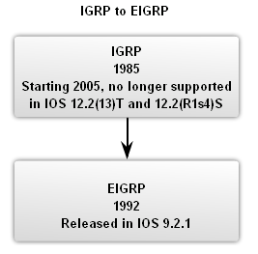
EIGRP
Roots of EIGRP: IGRP
  -Developed in 1985 to overcome RIPv1’s limited hop count
  -Distance vector routing protocol
  -Metrics used by IGRP
    bandwidth (used by default)
    Delay (used by default)
    reliability
    load
  -Discontinued support starting with IOS 12.2(13)T & 12.2(R1s4)S

Slide 5
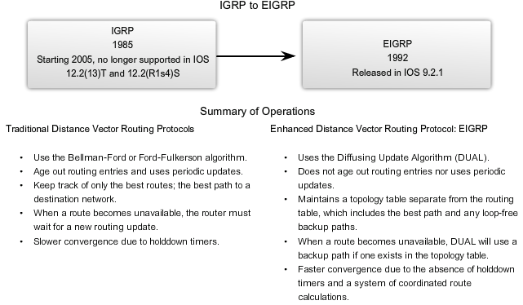
Roots

Slide 6
EIGRP
EIGRP Message Format
EIGRP Header
  Data link frame header - contains source and destination MAC address
  IP packet header - contains source & destination IP address
  EIGRP packet header - contains AS number
  Type/Length/Field - data portion of EIGRP message

Slide 7
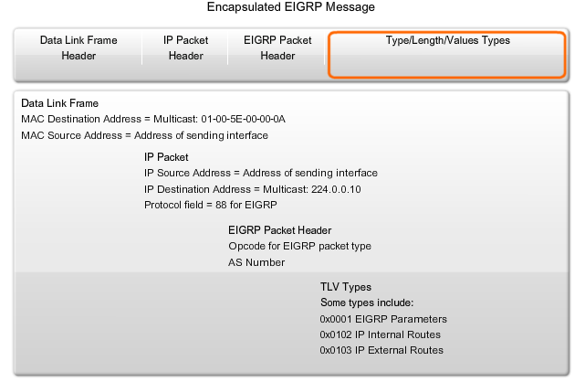
EIGRP Message

Slide 8
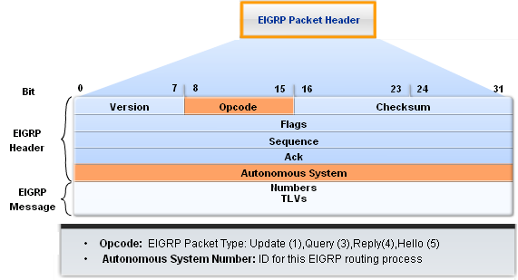
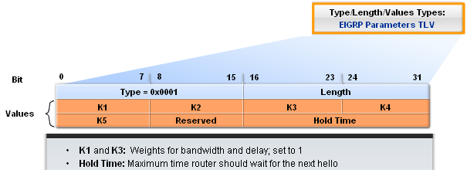
EIGRP
EIGRP packet header contains
  Opcode field
  Autonomous System number
EIGRP Parameters contains
  Weights
  Hold time

Slide 9
EIGRP Internal Fields
Delay is calculated as the sum of delays from source to destination in units of 10 microseconds. Bandwidth is the lowest configured bandwidth of any interface along the route.
The subnet mask is specified as the prefix length or the number of network bits in the subnet mask. For example, the prefix length for the subnet mask 255.255.255.0 is 24 because 24 is the number of network bits.
The Destination field stores the address of the destination network. Although only 24 bits are shown in this figure, this field varies based on the value of the network portion of the 32-bit network address.
For example, the network portion of 10.1.0.0/16 is 10.1. Therefore, the Destination field stores the first 16 bits. Because the minimum length of this field is 24 bits, the remainder of the field is padded with zeros.
If a network address is longer than 24 bits (192.168.1.32/27, for example), then the Destination field is extended for another 32 bits (for a total of 56 bits) and the unused bits are padded with zeros.

Slide 10
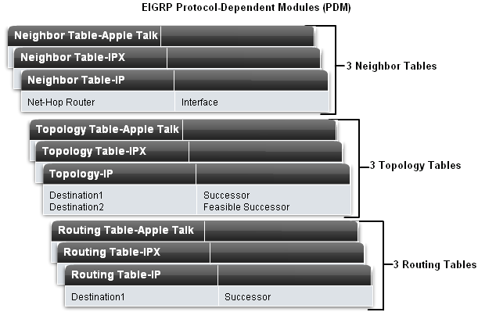
EIGRP
Protocol Dependent Modules (PDM)
EIGRP uses PDM to route several different protocols i.e. IP, IPX & AppleTalk
PDMs are responsible for the specific routing task for each network layer protocol

Slide 11
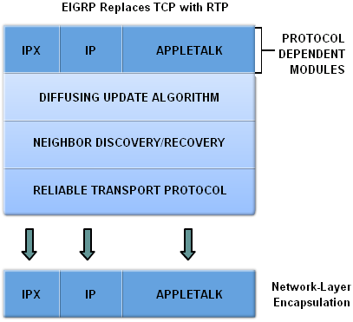
EIGRP
Reliable Transport Protocol (RTP)
Purpose of RTP
  Used by EIGRP to transmit and receive EIGRP packets
Characteristics of RTP
  Involves both reliable & unreliable delivery of EIGRP packet
    Reliable delivery requires acknowledgment from destination
    Unreliable delivery does not require an acknowledgement from destination
  Packets can be sent
    Unicast
    Multicast
      Using address 224.0.0.10

Slide 12
Note on RTP
Reliable Transport Protocol (RTP) is the protocol used by EIGRP for the delivery and reception of EIGRP packets.
EIGRP was designed as a Network layer independent routing protocol; therefore, it cannot use the services of UDP or TCP because IPX and Appletalk do not use protocols from the TCP/IP protocol suite. The figure shows conceptually how RTP operates.
Although "Reliable" is part of its name, RTP includes both reliable delivery and unreliable delivery of EIGRP packets, similar to TCP and UDP, respectively.
Reliable RTP requires an acknowledgement to be returned by the receiver to the sender. An unreliable RTP packet does not require an acknowledgement.

Slide 13
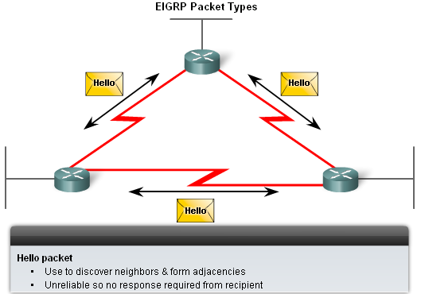
EIGRP
EIGRP’s 5 Packet Types
Hello packets
  Used to discover & form adjacencies with neighbors

Slide 14
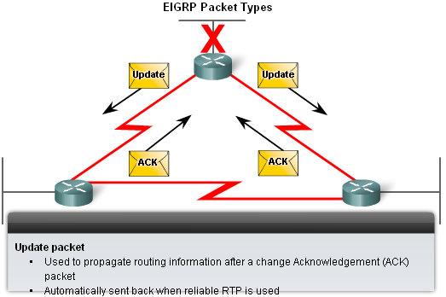
EIGRP
Update packets
  Used to propagate routing information
Acknowledgement packets
  Used to acknowledge receipt of update, query & reply packets

Slide 15
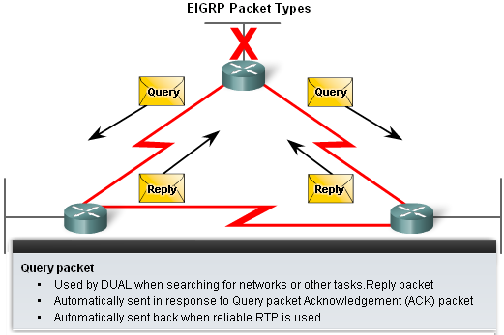
EIGRP
Query & Reply packets
  Used by DUAL for searching for networks
  Query packets
    -Can use
      Unicast
      Multicast
  Reply packet
    -Use only
      unicast

Slide 16
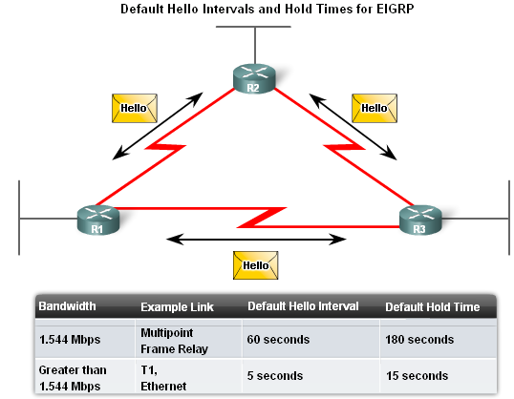
EIGRP
Purpose of Hello Protocol
  To discover & establish adjacencies with neighbor routers
Characteristics of hello protocol
  Time interval for sending hello packet
    Most networks it is every 5 seconds
    Multipoint non broadcast multi-access networks
      Unicast every 60 seconds
-Holdtime
    This is the maximum time router should wait before declaring a neighbor down
    Default holdtime
      3 times hello interval

Slide 17
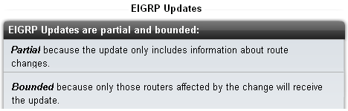
EIGRP
EIGRP Bounded Updates
EIGRP only sends update when there is a change in route status
Partial update
  A partial update includes only the route information that has changed – the whole routing table is NOT sent
Bounded update
  When a route changes, only those devices that are impacted will be notified of the change
EIGRP’s use of partial bounded updates minimizes use of bandwidth

Slide 18
Introduction to DUAL
The DUAL algorithm is used to obtain loop-freedom at every instant throughout a route computation.
This allows all routers involved in a topology change to synchronize at the same time. Routers that are not affected by the topology changes are not involved in the recomputation.
This method provides EIGRP with faster convergence times than other distance vector routing protocols.
The decision process for all route computations is done by the DUAL Finite State Machine.
In general terms, a finite state machine (FSM) is a model of behavior composed of a finite number of states, transitions between those states, and events or actions that create the transitions.
The DUAL FSM tracks all routes, uses its metric to select efficient, loop-free paths, and selects the routes with the least cost path to insert into the routing table.

Slide 19
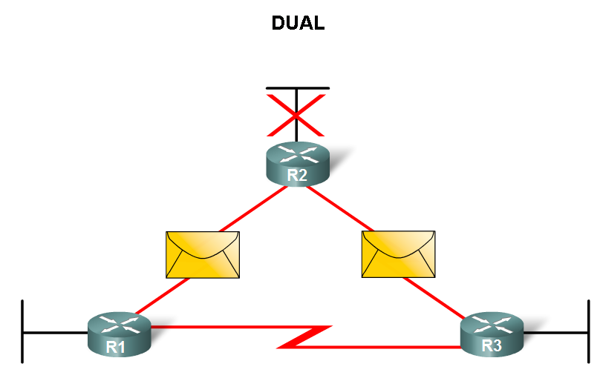
EIGRP
Diffusing Update Algorithm (DUAL)
  Purpose
    EIGRP’s primary method for preventing routing loops
  Advantage of using DUAL
    Provides for fast convergence time by keeping a list of loop-free backup routes

Slide 20
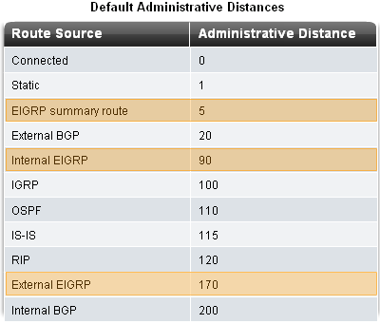
EIGRP
Administrative Distance (AD)
  Defined as the trustworthiness of the source route
EIGRP default administrative distances
  Summary routes = 5
  Internal routes = 90
  Imported routes = 170

Slide 21
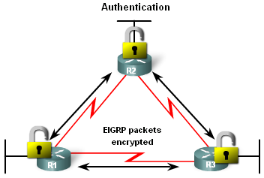
EIGRP
Authentication
EIGRP can
  Encrypt routing information
  Authenticate routing information

Slide 22
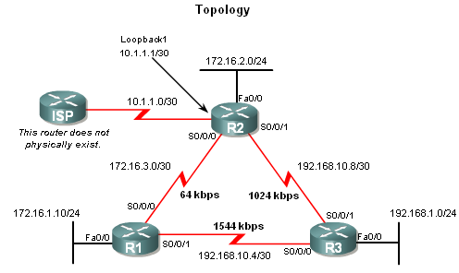
EIGRP
Network Topology
Topology used is the same as previous chapters with the addition of an ISP router

Slide 23
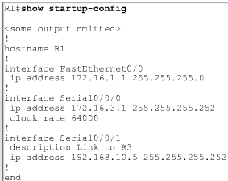
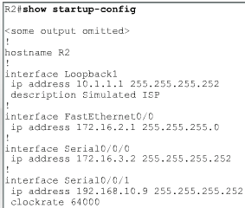
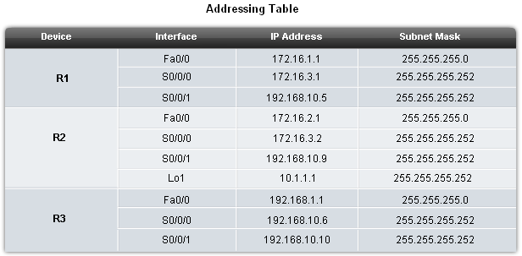
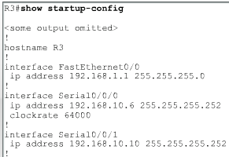
EIGRP
EIGRP will automatically summarize routes at classful boundaries

Slide 24
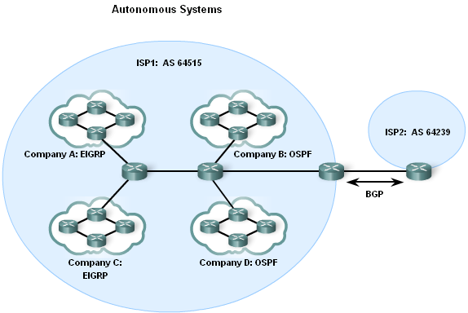
Basic EIGRP Configuration
Autonomous System (AS) & Process IDs
  This is a collection of networks under the control of a single authority (reference RFC 1930)
  AS Numbers are assigned by IANA
  Entities needing AS numbers
    ISP
    Internet Backbone prodiers
    Institutions connecting to other institutions using AS numbers

Slide 25
Process IDs
Both EIGRP and OSPF use a process ID to represent an instance of their respective routing protocol running on the router.
Router(config)#router eigrp autonomous-system
Although EIGRP refers to the parameter as an "autonomous-system" number, it actually functions as a process ID. This number is not associated with an autonomous system number discussed previously and can be assigned any 16-bit value.
Router(config)#router eigrp 1
In this example, the number 1 identifies this particular EIGRP process running on this router. In order to establish neighbor adjacencies, EIGRP requires all routers in the same routing domain to be configured with the same process ID. Typically, only a single process ID of any routing protocol would be configured on a router.

Slide 26
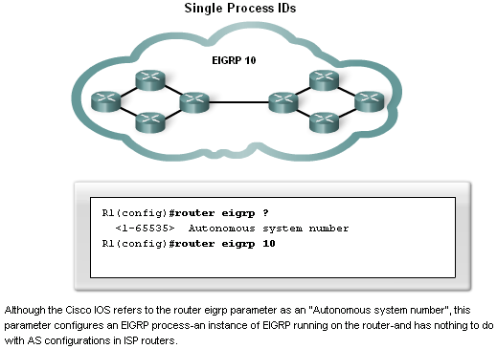
Basic EIGRP Configuration
EIGRP autonomous system number actually functions as a process ID
Process ID represents an instance of the routing protocol running on a router
Example
Router(config)#router
eigrp autonomous-system

Slide 27
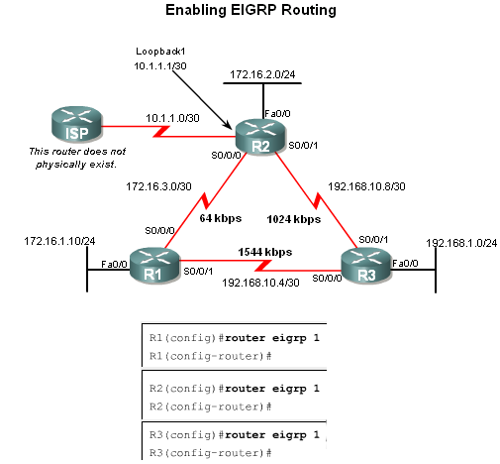
Basic EIGRP Configuration
The router eigrp command
The global command that enables eigrp is
  router eigrp autonomous-system
  -All routers in the EIGRP routing domain must use the same process ID number (autonomous-system number)

Slide 28
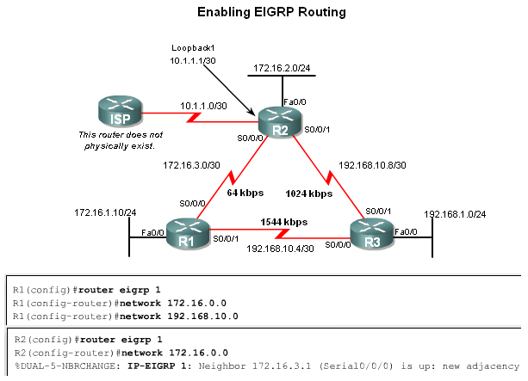
Basic EIGRP Configuration
The Network Command
Functions of the network command
  Enables interfaces to transmit & receive EIGRP updates
  Includes network or subnet in EIGRP updates
Example
  Router(config-router)#network network-address

Slide 29
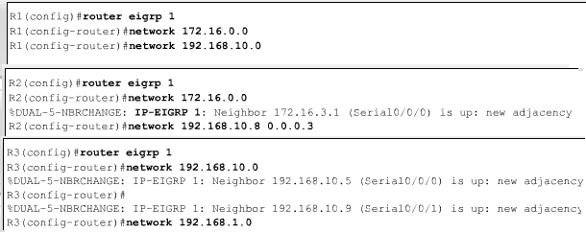
Basic EIGRP Configuration
The network Command with a Wildcard Mask
  -This option is used when you want to configure EIGRP to advertise specific subnets
  -Example
  Router(config-router)#network network-address [wildcard-mask]

Slide 30
Wildcard Mask
Think of a wildcard mask as the inverse of a subnet mask. The inverse of subnet mask 255.255.255.252 is 0.0.0.3. To calculate the inverse of the subnet mask, subtract the subnet mask from 255.255.255.255:
255.255.255.255
- 255.255.255.252
Subtract the subnet mask
---------------
0. 0. 0. 3
Wildcard mask

Slide 31
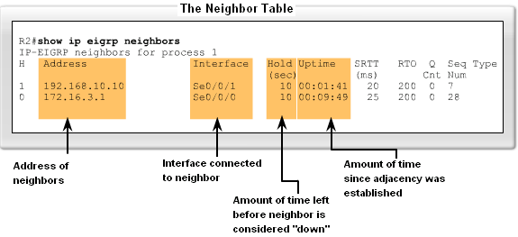
Basic EIGRP Configuration
Verifying EIGRP
EIGRP routers must establish adjacencies with their neighbors before any updates can be sent or received
Command used to view neighbor table and verify that EIGRP has established adjacencies with neighbors is
  show ip eigrp neighbors

Slide 32
Show EIGRP Neighbor Command
The output from the show ip eigrp neighbor command includes:
H column - Lists the neighbors in the order they were learned.
Address - The IP address of the neighbor.
Interface - The local interface on which this Hello packet was received.
Hold - The current hold time. Whenever a Hello packet is received, this value is reset to the maximum hold time for that interface and then counts down to zero. If zero is reached, the neighbor is considered "down".
Uptime - Amount of time since this neighbor was added to the neighbor table.
SRTT (Smooth Round Trip Timer) and RTO (Retransmit Interval) - Used by RTP to manage reliable EIGRP packets. SRTT and RTO are discussed further in CCNP courses.
Queue Count - Should always be zero. If more than zero, then EIGRP packets are waiting to be sent. Queue count is discussed further in CCNP courses.
Sequence Number - Used to track updates, queries, and reply packets. Sequence numbers are discussed further in CCNP courses.

Slide 33
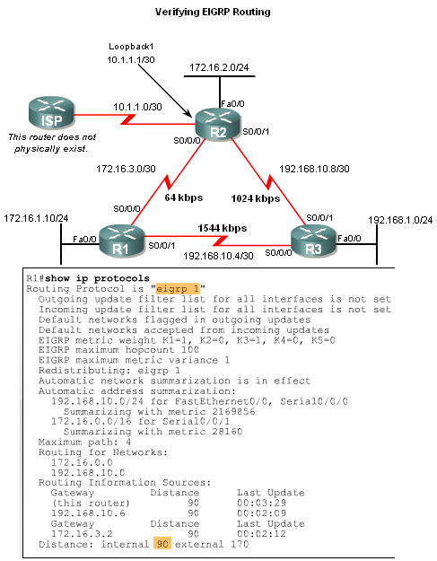
EIGRP
The show ip protocols command is also used to verify that EIGRP is enabled

Slide 34
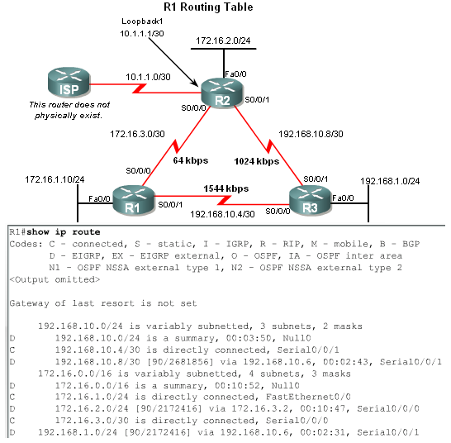
Basic EIGRP Configuration
Examining the Routing Table
The show ip route command is also used to verify EIGRP
EIGRP routes are denoted in a routing table by the letter “D”
By default , EIGRP automatically summarizes routes at major network boundary

Slide 35
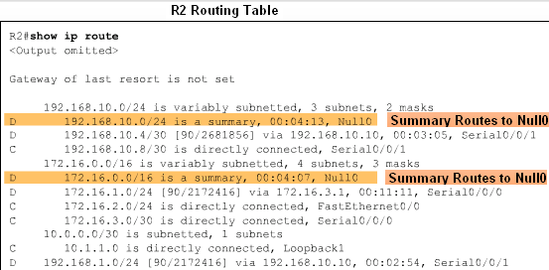
Basic EIGRP Configuration
Introducing the Null0 Summary Route
  Null0 is not a physical interface
  In the routing table summary routes are sourced from Null0
    Reason: routes are used for advertisement purposes
  EIGRP will automatically include a null0 summary route as child route when 2 conditions are met
    At least one subnet is learned via EIGRP
    Automatic summarization is enabled

Slide 36
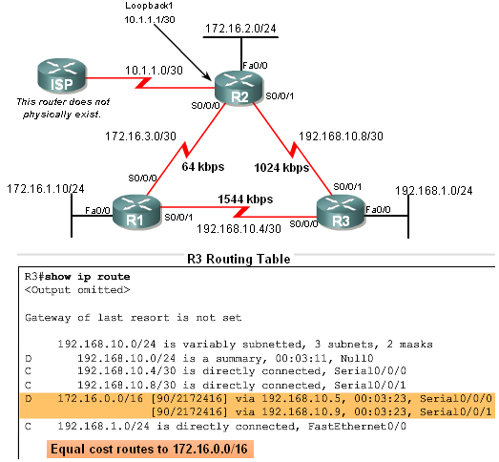
Basic EIGRP Configuration
R3’s routing table shows that the 172.16.0.0/16 network is automatically summarized by R1 & R3

Slide 37
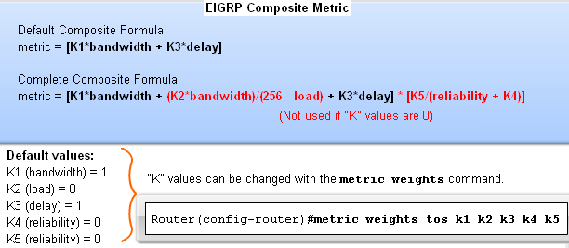
EIGRP Metric Calculation
EIGRP Composite Metric & the K Values
EIGRP uses the following values in its composite metric
  -Bandwidth, delay, reliability, and load
The composite metric used by EIGRP
  formula used has values K1 →K5
      K1 & K3 = 1
      all other K values = 0

Slide 38
Composite Metric Values
The figure shows the composite metric formula used by EIGRP. The formula consists of values K1 through K5, known as EIGRP metric weights. By default, K1 and K3 are set to 1, and K2, K4, and K5 are set to 0. The result is that only the bandwidth and delay values are used in the computation of the default composite metric.
The default K values can be changed with the EIGRP router command:
Router(config-router)#metric weights tos k1 k2 k3 k4 k5
Modifying the metric weights is beyond the scope of this course, but their relevance is important in establishing neighbors and is discussed in a later section. The tos (Type of Service) value is left over from IGRP and was never implemented. The tos value is always set to 0.

Slide 39
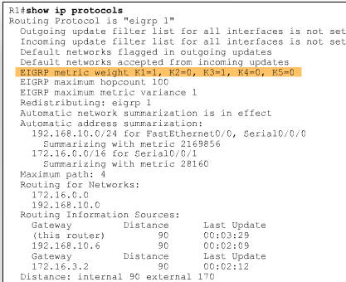
EIGRP Metric Calculation
Use the sh ip protocols command to verify the K values

Slide 40
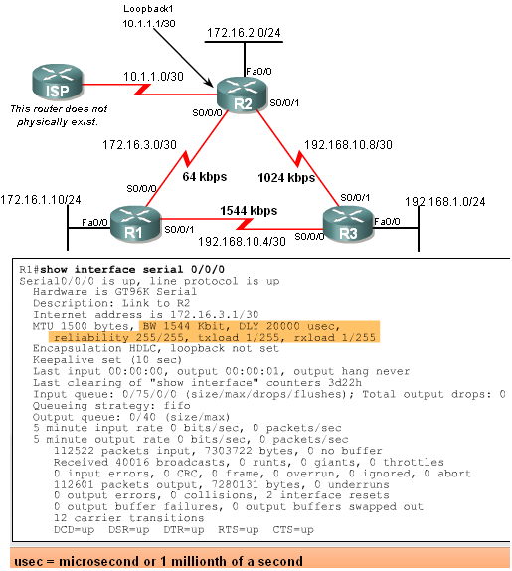
EIGRP Metric Calculation
EIGRP Metrics
Use the show interfaces command to view metrics
EIGRP Metrics
  Bandwidth – EIGRP uses a static bandwidth to calculate metric
  Most serial interfaces use a default bandwidth value of 1.544Mbos (T1)

Slide 41
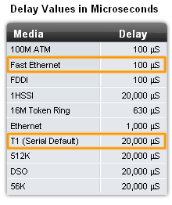
EIGRP Metric Calculation
EIGRP Metrics
Delay is the defined as the measure of time it takes for a packet to traverse a route
  -it is a static value based on link type to which interface is connected

Slide 42
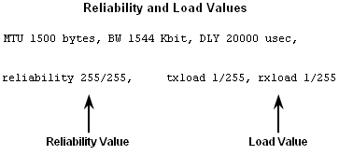
EIGRP Metric Calculation
Reliability (not a default EIGRP metric)
  -A measure of the likelihood that a link will fail
  -Measure dynamically & expressed as a fraction of 255
  the higher the fraction the better the reliability
Load (not a default EIGRP metric)
  A number that reflects how much traffic is using a link
  Number is determined dynamically and is expressed as a fraction of 255
    The lower the fraction the less the load on the link

Slide 43
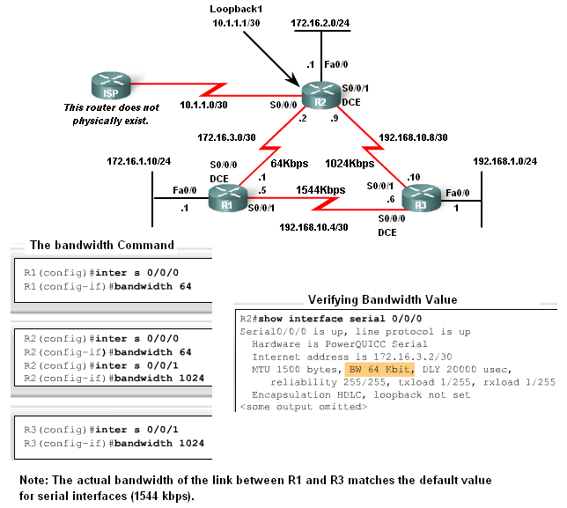
EIGRP Metric Calculation
Using the Bandwidth Command
Modifying the interface bandwidth
  -Use the bandwidth command
  -Example
  Router(config-if)#bandwidth kilobits
Verifying bandwidth
  Use the show interface command
Note – bandwidth command
does not change the
link’s physical
bandwidth

Slide 44
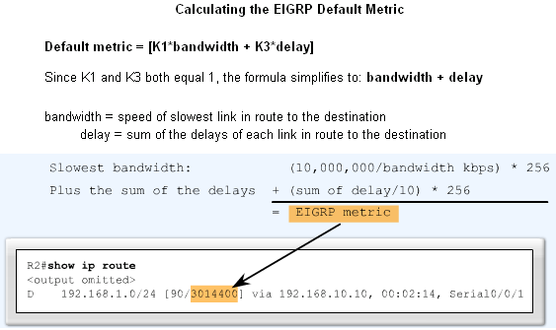
EIGRP Metric Calculation
The EIGRP metric can be determined by examining the
bandwidth delay

Slide 45
Calculating Metrics in EIGRP
The figure shows the composite metric used by EIGRP. Using the default values for K1 and K3, we can simplify this calculation to: the slowest bandwidth (or minimum bandwidth) plus the cumulative sum of all of the delays.
In other words, by examining the bandwidth and delay values for all of the outgoing interfaces of the route, we can determine the EIGRP metric.
First, determine the link with the slowest bandwidth. That bandwidth is used for the (10,000,000/bandwidth) * 256 portion of the formula.
Next, determine the delay value for each outgoing interface on the way to the destination.
Sum the delay values and divide by 10 (sum of delay/10) and then multiply by 256 (* 256). Add the bandwidth and sum of delay values to obtain the EIGRP metric.
The routing table output for R2 shows that the route to 192.168.1.0/24 has an EIGRP metric of 3,014,400. Let's see exactly how EIGRP calculated this value.

Slide 46
EIGRP Metric Calculation
EIGRP uses the lowest bandwidth (BW)in its metric calculation
Calculated BW = reference BW / lowest BW(kbps)
Delay – EIGRP uses the cumulative sum of all outgoing interfaces
  Calculated Delay = the sum of outgoing interface delays
EIGRP Metric = calculated BW + calculated delay

Slide 47
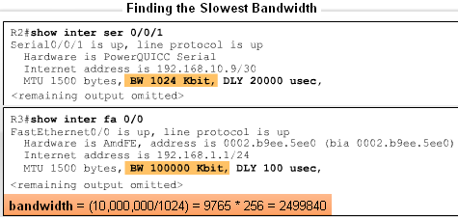
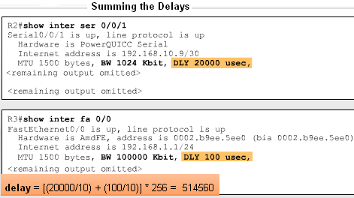
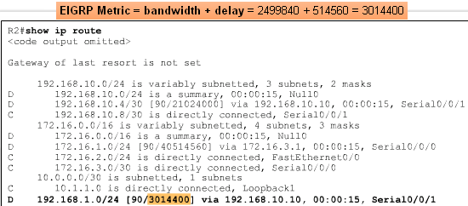
EIGRP Metric Calculation

Slide 48
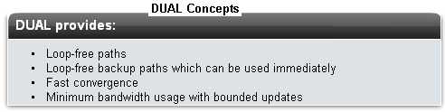
DUAL Concepts
The Diffusing Update Algorithm (DUAL) is used to prevent looping

Slide 49
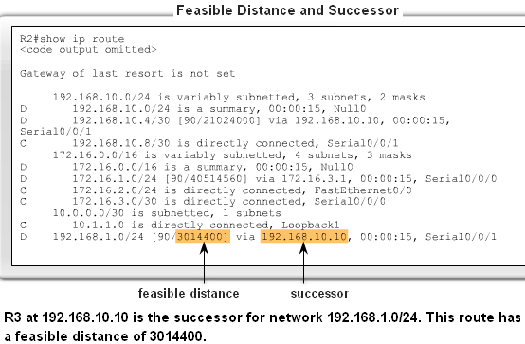
DUAL Concepts
Successor
  The best least cost route to a destination found in the routing table
Feasible distance
  The lowest calculated metric along a path to a destination network

Slide 50
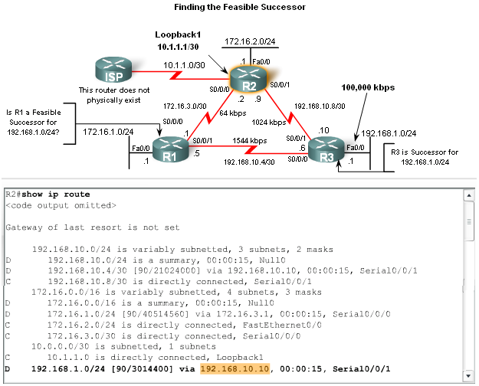
DUAL Concepts
Feasible Successors, Feasibility Condition & Reported Distance
Feasible Successor
  -This is a loop free backup route to same
  destination as successor route

Slide 51
Feasible Successor
One of the reasons DUAL can converge quickly after a change in the topology is because it can use backup paths to other routers known as feasible successors without having to recompute DUAL.
A feasible successor (FS) is a neighbor who has a loop-free backup path to the same network as the successor by satisfying the feasibility condition.
In our topology, would R2 consider R1 to be a feasible successor to network 192.168.1.0/24?
In order to be a feasible successor, R1 must satisfy the feasibility condition (FC). Let's examine what that means.

Slide 52
Feasibility Condition
The feasibility condition (FC) is met when a neighbor's reported distance (RD) to a network is less than the local router's feasible distance to the same destination network.
The reported distance or advertised distance is simply an EIGRP neighbor's feasible distance to the same destination network.
The reported distance is the metric that a router reports to a neighbor about its own cost to that network.
If R3 is the successor, can the neighbor R1 be a feasible successor to this same 192.161.0/24 network?
In other words, if the link between R2 and R3 fails can R1 immediately be used as a backup path without a recomputation of the DUAL algorithm? R1 can only be a feasible successor if it meets the feasibility condition.

Slide 53
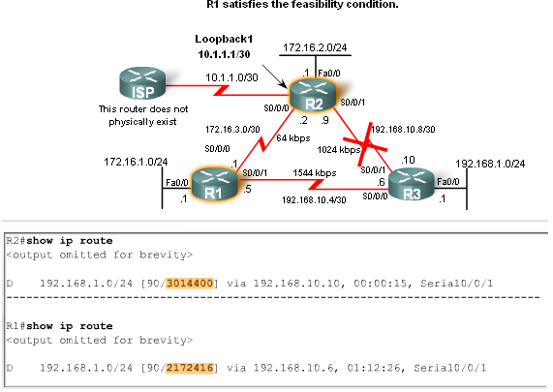
DUAL Concepts
Feasible Successors, Feasibility Condition & Reported Distance
Reported distance (RD)
  -The metric that a router reports to a neighbor about its own cost to that network

Slide 54
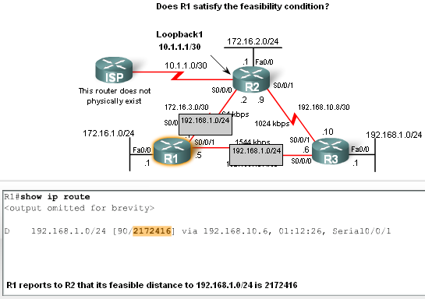
DUAL Concepts
Feasibility Condition (FC)
  -Met when a neighbor’s RD is less than the local router’s FD to the same destination network

Slide 55
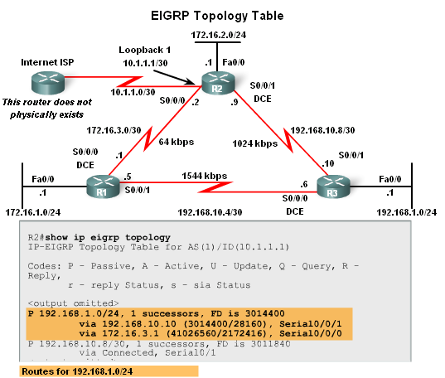
DUAL Concepts
Topology Table: Successor & Feasible Successor
EIGRP Topology table
  Viewed using the show ip eigrp topology command
    Contents of table include:
      all successor routes
      all feasible successor routes

Slide 56
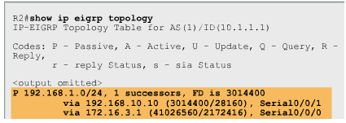
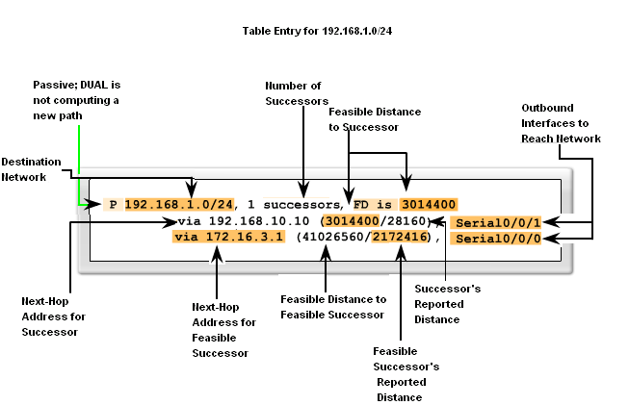
DUAL Concepts
EIGRP Topology Table dissected

Slide 57

DUAL Concepts
Topology Table: No Feasible Successor
A feasible successor may not be present because the feasibility condition may not be met
  -In other words, the reported distance of the neighbor is greater than or equal to the current feasible distance

Slide 58
DUAL Concepts
Finite Sate Machine (FSM)
  An abstract machine that defines a set of possible states something can go through, what event causes those states and what events result form those states
  FSMs are used to describe how a device, computer program, or routing algorithm will react to a set of input events

Slide 59

DUAL Concepts
DUAL FSM
  Selects a best loop-free path to a destination
  Selects alternate routes by using information in EIGRP tables

Slide 60

DUAL Concepts
Finite State Machines (FSM)
To examine output from EIGRP’s finite state machine us the debug eigrp fsm command

Slide 61
More EIGRP Configurations
The Null0 Summary Route
By default, EIGRP uses the Null0 interface to discard any packets that match the parent route but do not match any of the child routes
EIGRP automatically includes a null0 summary route as a child route whenever both of the following conditions exist
  One or subnets exists that was learned via EIGRP
  Automatic summarization is enabled

Slide 62

More EIGRP Configurations
The Null0 Summary Route

Slide 63
More EIGRP Configurations
Disabling Automatic Summarization
The auto-summary command permits EIGRP to automatically summarize at major network boundaries
The no auto-summary command is used to disable automatic summarization
  This causes all EIGRP neighbors to send updates that will not be automatically summarized
    this will cause changes to appear in both
        -routing tables
        -topology tables

Slide 64
More EIGRP Configurations
Manual Summarization
Manual summarization can include supernets
  Reason: EIGRP is a classless routing protocol & include subnet mask in update
Command used to configure manual summarization
  Router(config-if)#ip summary-address eigrp as-number network-address subnet-mask

Slide 65

More EIGRP Configurations
Configuring a summary route in EIGRP

Slide 66
More EIGRP Configurations
EIGRP Default Routes
“quad zero” static default route
  -Can be used with any currently supported routing protocol
  -Is usually configured on a router that is connected a network outside the EIGRP domain
EIGRP & the “Quad zero” static default route
  Requires the use of the redistribute static command to disseminate default route in EIGRP updates

Slide 67

More EIGRP Configurations
Fine-Tuning EIGRP
EIGRP bandwidth utilization
  -By default, EIGRP uses only up to 50% of interface bandwidth for EIGRP information
  -The command to change the percentage of bandwidth used by EIGRP is
  Router(config-if)#ip bandwidth-percent eigrp as- number percent

Slide 68

More EIGRP Configurations
Configuring Hello Intervals and Hold Times
  -Hello intervals and hold times are configurable on a per-interface basis
  -The command to configure hello interval is
  Router(config-if)#ip hello-interval eigrp as-number seconds
Changing the hello interval also requires changing the hold time to a value greater than or equal to the hello interval
  -The command to configure hold time value is
  Router(config-if)#ip hold-time eigrp as-number seconds

Slide 69
Summary
Background & History
  EIGRP is a derivative of IGRP
    EIGRP is a Cisco proprietary distance vector routing protocol released in 1994
EIGRP terms and characteristics
  EIGPR uses RTP to transmit & receive EIGRP packets
  EIGRP has 5 packet type:
    Hello packets
    Update packets
    Acknowledgement packets
    Query packets
    Reply packets
  Supports VLSM & CIDR

Slide 70
Summary
EIGRP terms and characteristics
  EIGRP uses a hello protocol
    Purpose of hello protocol is to discover & establish adjacencies
  EIGRP routing updates
    Aperiodic
    Partial and bounded
    Fast convergence

Slide 71
Summary
EIGRP commands
  The following commands are used for EIGRP configuration
    RtrA(config)#router eigrp [autonomous-system #]
    RtrA(config-router)#network network-number
  The following commands can be used to verify EIGRP
    Show ip protocols
    Show ip eigrp neighbors
    Show ip route

Slide 72
Summary
EIGRP metrics include
  Bandwidth (default)
  Delay (default)
  Reliability
  Load

Slide 73
Summary
DUAL
  Purpose of DUAL
    To prevent routing loops
  Successor
    Primary route to a destination
  Feasible successor
    Backup route to a destination
  Feasible distance
    Lowest calculated metric to a destination
  Reported distance
    The distance towards a destination as advertised by an upstream neighbor

Slide 74
Summary
Choosing the best route
  After router has received all updates from directly connected neighbors, it can calculate its DUAL
    1st metric is calculated for each route
    2nd route with lowest metric is designated successor & is placed in routing table
    3rd feasible successor is found
      Criteria for feasible successor: it must have lower reported distance to the destination than the installed route’s feasible distance
      Feasible routes are maintained in topology table

Slide 75
Summary
Automatic summarization
  On by default
  Summarizes routes on classful boundary
  Summarization can be disabled using the following command
    RtrA(config-if)#no auto-summary

